Slide 1
Air Systems Modelling and Simulation
Model & Sizing of Aircraft Air-Conditioning Systems – 2023

Slide 2
Agenda
Air Systems functions
System modelisation
Dymola overview
Dymola exercise
System modelisation at Liebherr Toulouse
Future of system simulation
Fluid Modelling and Humidity effect
Flow schedule Usecase & exercise

Slide 3
Air Systems

Slide 4
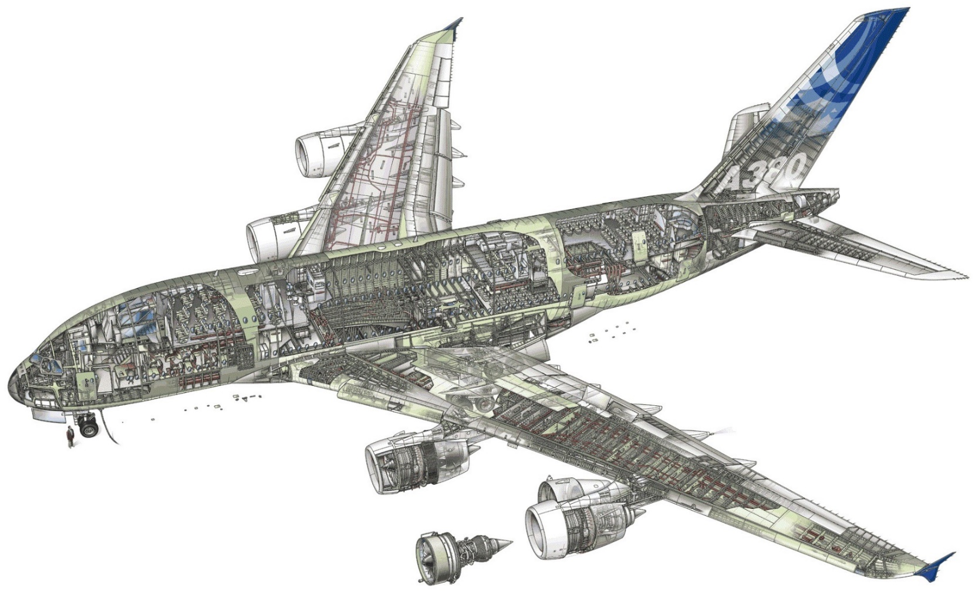
Main Aircraft Operational Functions
Air Systems
Ensure A/C Integrity
Air Systems
Transport Passengers
Limit Mechanical Loads
Maintain Metabolic Functions (O2)
Maintain Humans Alive
Protect from Hypothermia
Protect from Hyperthermia
Offer Comfortable Travel
Offer Air Conditioning

Slide 5
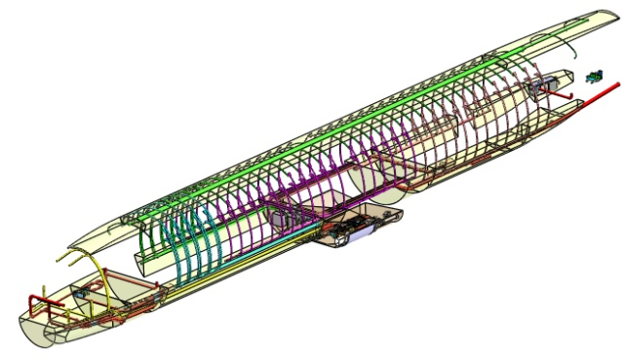
Distribution and Cabin Pressurization Systems
Air Systems
DS & CPCS
Adapt Zone Air Temperature
Distribute Air over Zones
Recirculate Zone Air
Protect Aircraft From Pressure Loads
Provide Adapted Pressure for Human
Acronym
DS : Distribution System
CPCS : Cabin Pressurization Control System
Passengers Air Distribution Ducts
Air Conditionning Packs
Recirculation Fans
Pilots Air Distribution Ducts

Slide 6
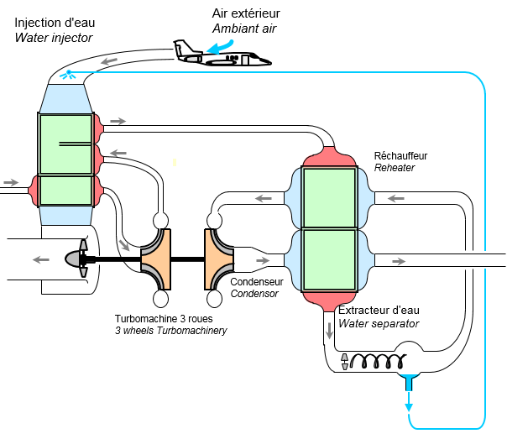
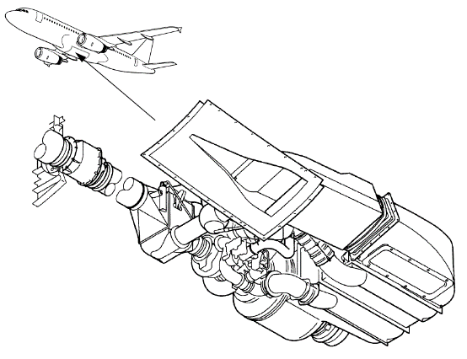
Environmental Control System
Air Systems
Acronym
ECS : Environmental Control System
ECS
Provide enough fresh air
Provide Cold Air
Provide Hot Air
Reduce Humidity level
„Classical“ ECS Architecture
ECS Integration

Slide 7
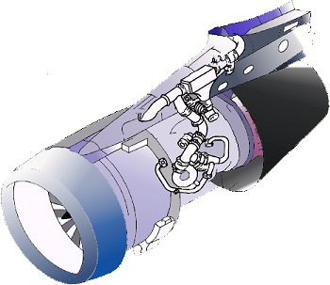
Bleed Air System
Air Systems
Acronym
BAS : Bleed Air System
EBAS : Engine Bleed Air System
BAS
Maintain Consumers in Operation
Protect Consumers from Engine
Select Power Source
Protect Aircraft from Hazard
„Classical“ EBAS Architecture
Air Consumers
Air Sources
EBAS Integration

Slide 8
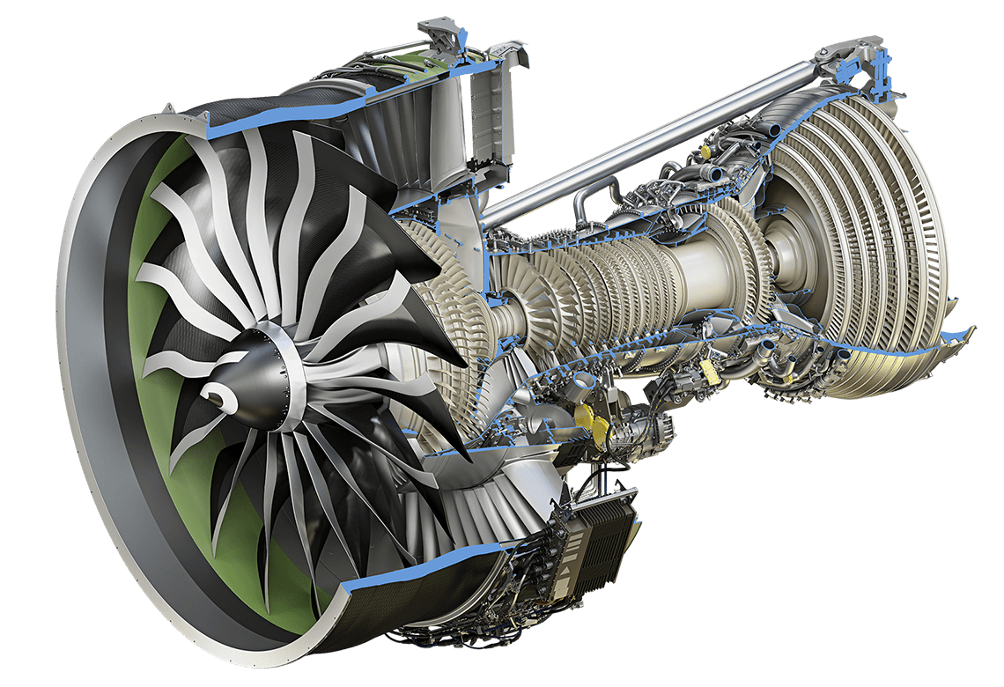


Architecture Synthesis
Air Systems
Conventional Aircraft Air Systems Architecture
Ambient
Ambient
Air
Air
ENG
BAS
ECS
DS
CABIN
APU
WIPS
CPCS
HPGC
APS
Ambient
Ambient
Ambient
Air
Air
Air

Slide 9
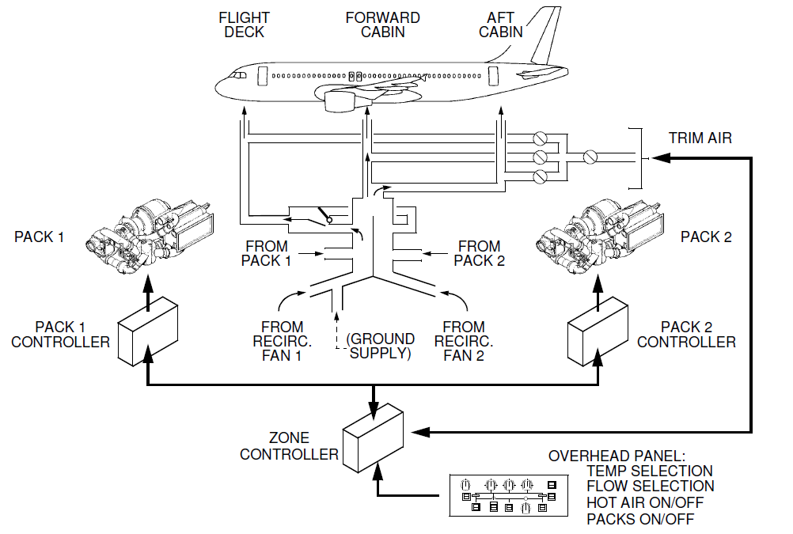
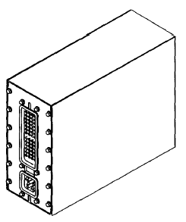
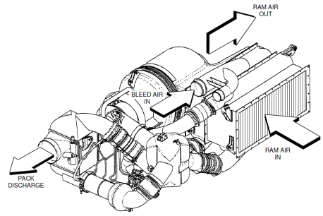
System Type
Air Systems
Computer
Commands
Sensors
Configuration
Air Systems:
Cyber-Physical Systems
Physical Hardware

Slide 10
System Simulation

Slide 11
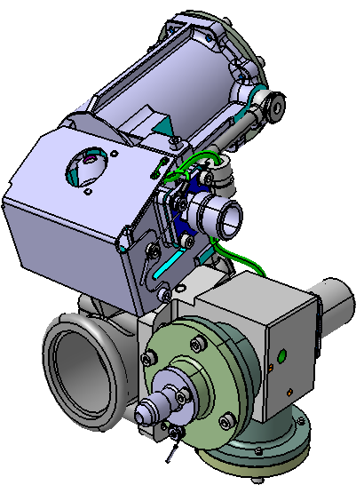
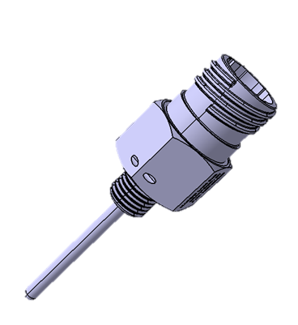
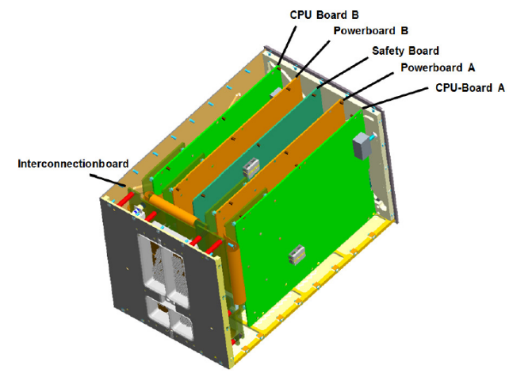
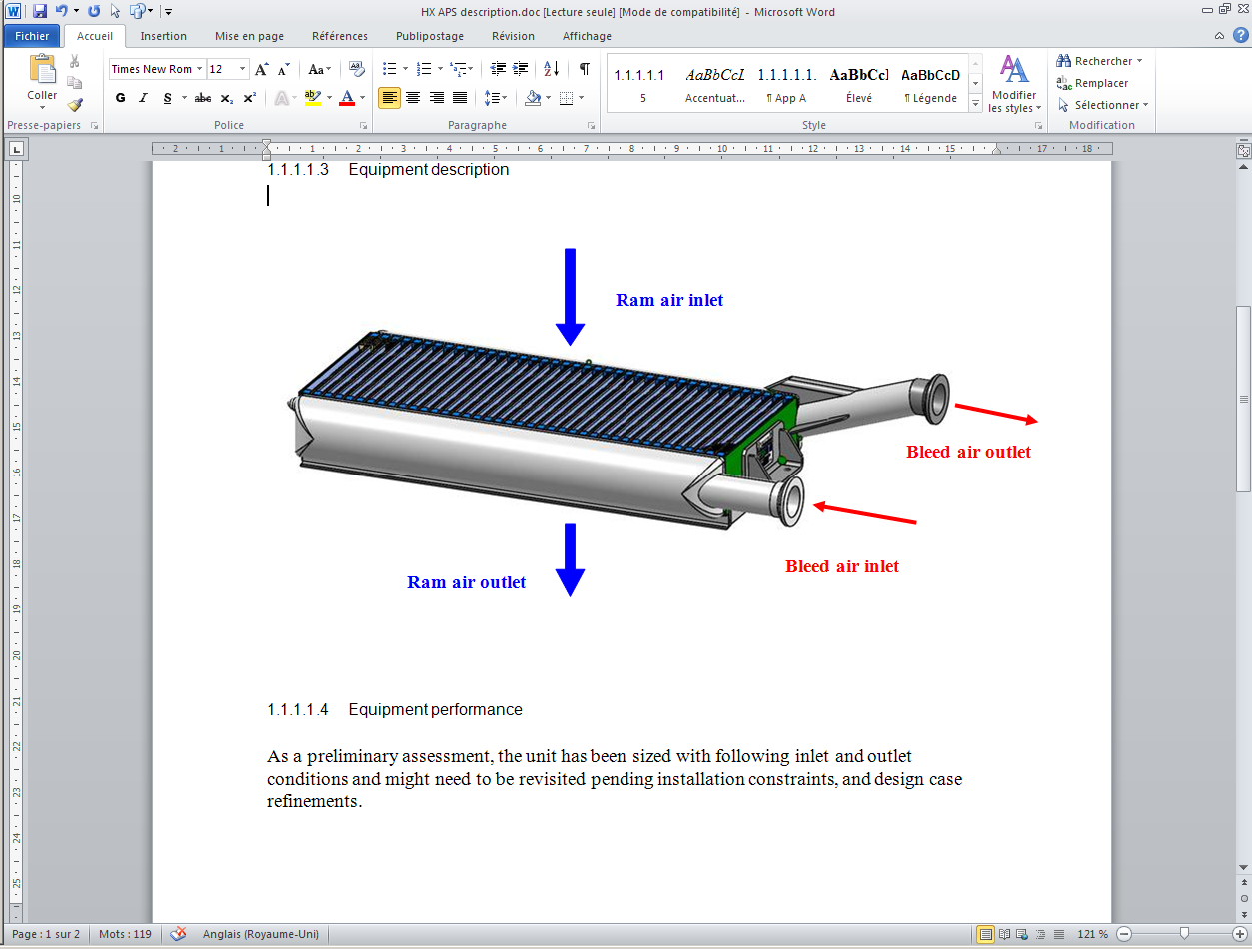
What is a System ?
System Simulation
///
Assembly of “sub-elements” with more simple functions : Complexity Management
Main Equipment Function(s)
Temperature Sensor
Pneumatic Valve
Modulate Electrical Resistance w. Temperature
Modulate Permeability
Computer
Acquire Sensors
Heat Exchanger
Compute Commands
Exchange Heat
Command Actuators

Slide 12
What is a System ?
System Simulation
///
Emergence of System function(s) thanks to the chosen Architecture : High Level Services
Temperature Regulation
Air Preparation System Architecture
Heat Exchanger
Temperature Sensor
Control Temperature
System Architecture is results of design choices !
Properties
Temperature Regulation Performances
Temperature Limitations
Failures Modes
Monitoring
Reconfiguration
…
Pneumatic Valve
Computer

Slide 13
What is Simulation ?
System Simulation
///
Simulation is a support for Analysis
Design Activity
Analysis Activity
Design Feedback & Validation
Requirements
Need Elicitation
Analysis Results
Test Benches
Simulation
Needs Analysis
Design Choices
Theory
Architecture Principles
Design Questions
Engineering Assessment
Solution

Slide 14
What is Simulation ?
System Simulation
///
Simulation Requires a large set of information as input
Definition
Simulation
Requirements to Validate / Verify
Model
Multi-physical equations
Control Equations
Events Modelling
Safety,…
Results
Produced data (unknowns,…)
Parameters
Properties
Solver
Robustness, Accuracy, Computational Cost
Test Scenarii

Slide 15

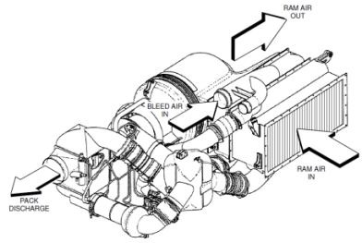
What is “System Simulation” ?
System Simulation
///
Performance Example
System Definition
Computer
Modeling of
Cyber-Physical Systems
Interfaces
Architecture
Commands
Sensors
System Performances
Configuration
Functions
Equip. Performances
Physical Hardware
Physical Domains
Thermal
Pneumatic
Mechanics
Hydraulic
Electrical
Control

Slide 16
Dymola (Short) Overview

Slide 17

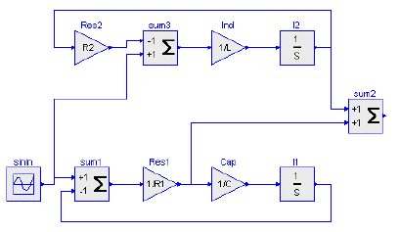
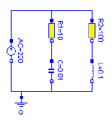
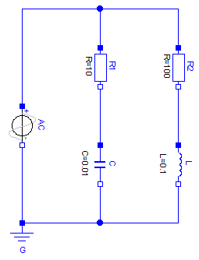
MODELICA & DYMOLA Overview
Dymola (Short) Overview
MODELICA
Mathematical bloc modeling (causal)
Define the mathematical problem including simplifications (by hand) and causality (boundaries)
Implement the mathematical problem by avoiding algebraic loops
System of Interest
Ex : Simulink, …
Organic modeling (acausal)
Define the physical equations of each components
Implement the physical equations
The MODELICA interpreter will perform the final implementation by simplifying and determining the causality itself
Ex : Modelica, SimScape, …

Slide 18
MODELICA & DYMOLA Overview
Dymola (Short) Overview
MODELICA
Organic Modeling
Component
Interface
Connection
Interface
Environment
Connectors: Definition of exchanged variables (depending on physical domains)
Interface: Set of connectors (potentially using several physical domains)
Component: Relations between connectors variables

Slide 19
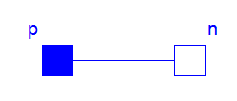

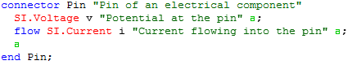

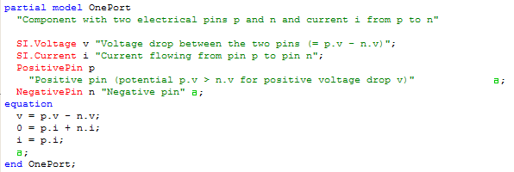
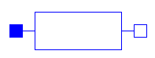
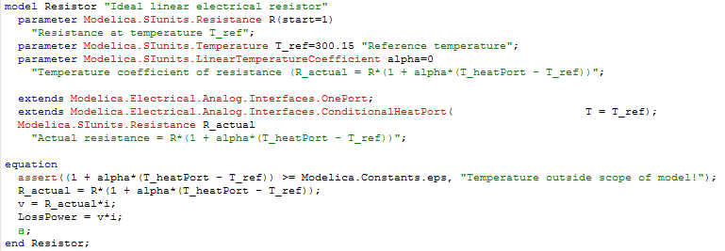
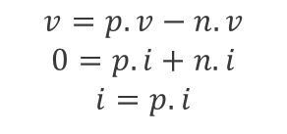
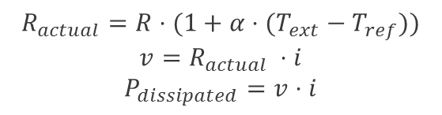
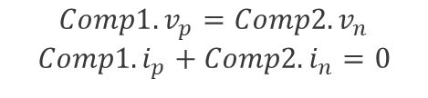
MODELICA & DYMOLA Overview
Dymola (Short) Overview
MODELICA
Connector
Comp1
Connection
Comp2
Definition of exchanged variables
Generate
$${Comp1.v}_{p}={Comp2.v}_{n}$$
$${Comp1.i}_{p}+{Comp2.i}_{n}=0$$
Interface
Definition of connectors
Generic relations
Interface for basic electrical components with two pins (positive and negative)
$$v=p.v−n.v$$
$$0=p.i+n.i$$
$$i=p.i$$
Component
Definition of component relations
MODELICA Description
$$R_{actual}=R⋅(1+α⋅(T_{ext}−T_{ref}))$$
$$v=R_{actual} ⋅i$$
$$P_{dissipated}=v⋅i$$

Slide 20
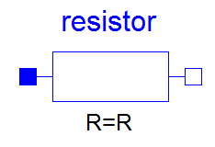
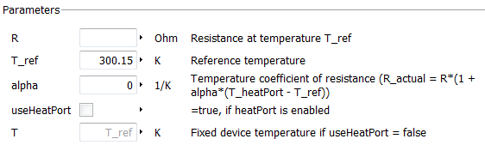
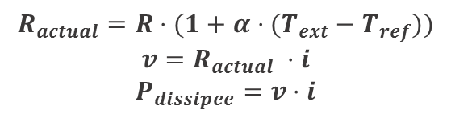
MODELICA & DYMOLA Overview
Dymola (Short) Overview
MODELICA
Parameters
Variables
$$R_{actual}=R⋅(1+α⋅(T_{ext}−T_{ref}))$$
$$v=R_{actual} ⋅i$$
$$P_{dissipee}=v⋅i$$
Equations
Automatic Component Interface Generation from parameters description

Slide 21
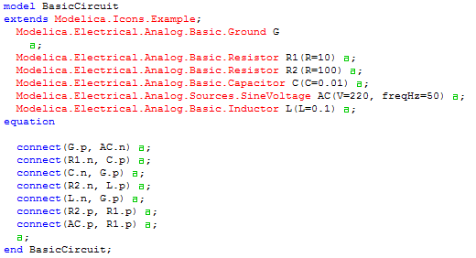
MODELICA & DYMOLA Overview
Dymola (Short) Overview
MODELICA
A model could describes the following elements :
Connectors
Parameters
Variables
Sub-components
Equations
Algorithms
…
Graphical representation described by the MODELICA source code
Modelica source code could be generated graphically

Slide 22
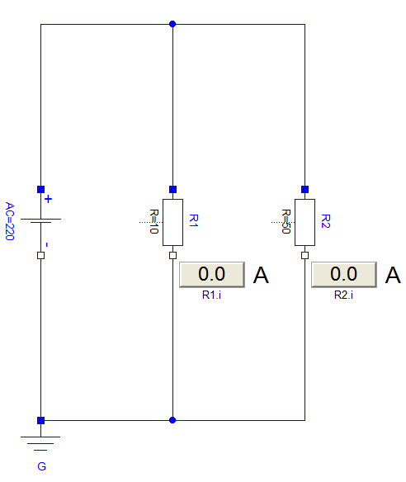
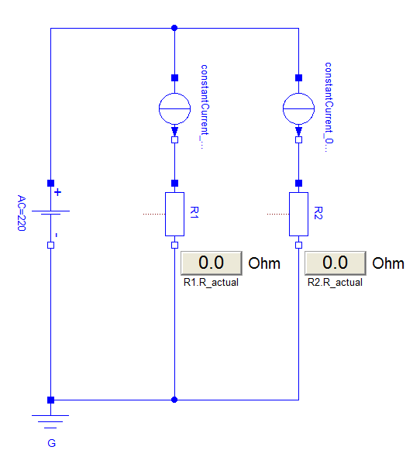
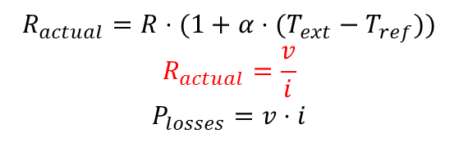
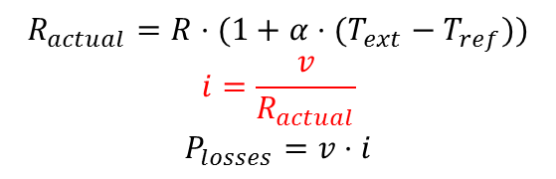
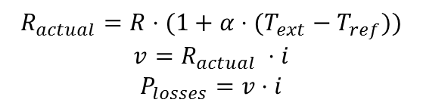
MODELICA & DYMOLA Overview
Dymola (Short) Overview
MODELICA
Component
Executable Model 1
Executable Model 2
Acausal Description
Determined Causality (automatic)
Determined Causality (automatic)
$$R_{actual}=R⋅(1+α⋅(T_{ext}−T_{ref}))$$
$$v=R_{actual} ⋅i$$
$$P_{losses}=v⋅i$$
$$R_{actual}=R⋅(1+α⋅(T_{ext}−T_{ref}))$$
$$i=\frac{v}{R_{actual}}$$
$$P_{losses}=v⋅i$$
$$R_{actual}=R⋅(1+α⋅(T_{ext}−T_{ref}))$$
$$R_{actual}=\frac{v}{i}$$
$$P_{losses}=v⋅i$$

Slide 23
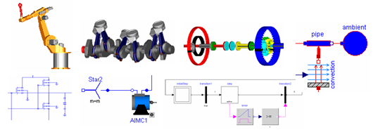
MODELICA & DYMOLA Overview
Dymola (Short) Overview
MODELICA
Modelica Standard Library (« MSL »)
- Version 3.2.2 (Dymola 2017 FD01)
- 1600 Models & Blocs
Standard managed by the MODELICA Association
ABB, AIT, DLR, Dassault Système, Fraunhofer, ITI, Modelon, TU Hamburg-Harburg, Politecnico di Milano, XRG Simulation
MODELICA

Slide 24





MODELICA & DYMOLA Overview
Dymola (Short) Overview
Physical or non physical entities description language (continuous, discrete)
Object oriented
Mathematical equations and algorithm handling
Graphical representation management
Models documentation
Independent from the solver
Language
MODELICA
Graphical editor of the MODELICA language for all its aspects
Icon, Diagram, Documentation and source code MODELICA
Management of MODELICA source code files and storage
Models consistency checking (number of equation equal to unknowns)
Equations manipulation and simplification
C code generation to build the simulation executable
Editor Compiler Launcher
Dymola
« Generate »
« Generate »
« Interpret »
Process
Code.c
Visual C++ Express 2010
MODELICA
Dymola
« Launch »
« Display »
« Compile »
« Compile »
« Interpret »
« Generate »
Projet.mo
resultat.mat
dymosim.exe
fmu.dll

Slide 25
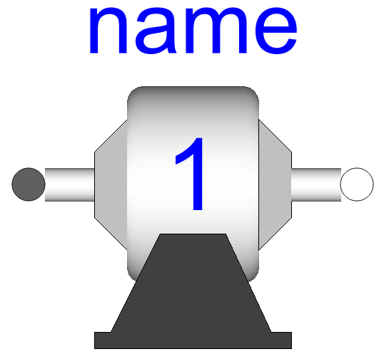
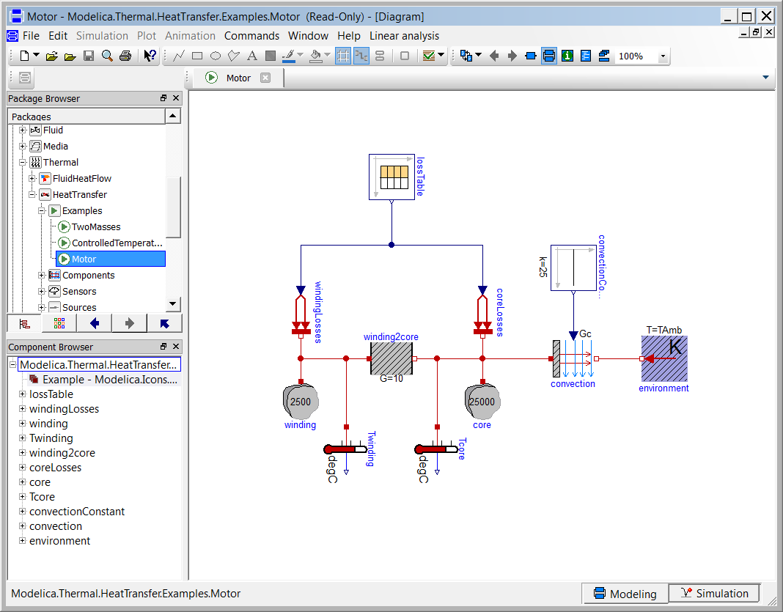
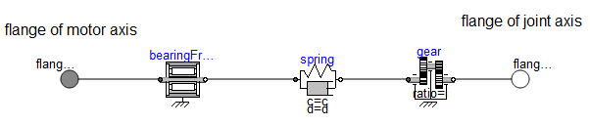
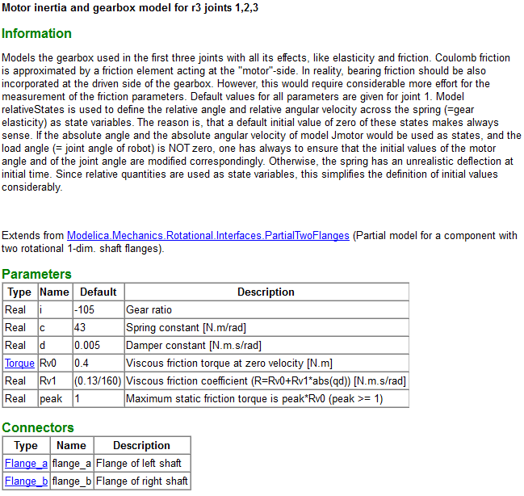
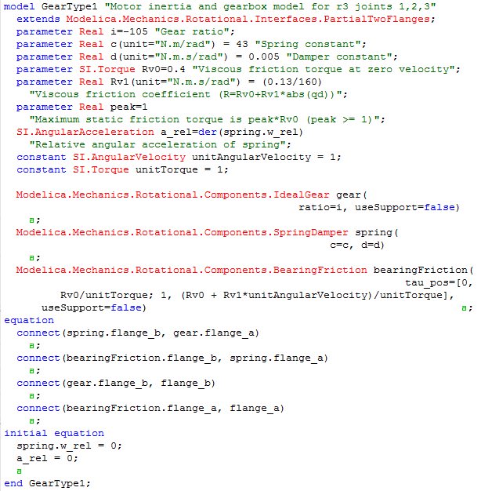
MODELICA & DYMOLA Overview
Dymola (Short) Overview
Dymola
Modeling Interface
Icon
Diagram
Documentation
MODELICA source code
Model « views »
Icon, Diagram, Documentation, Modelica
Models Libraries
Hierarchical models list

Slide 26
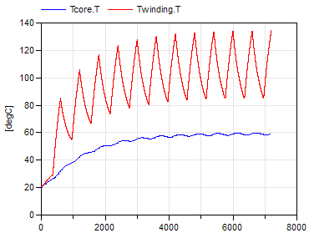
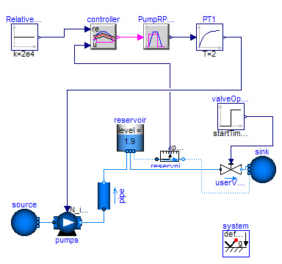
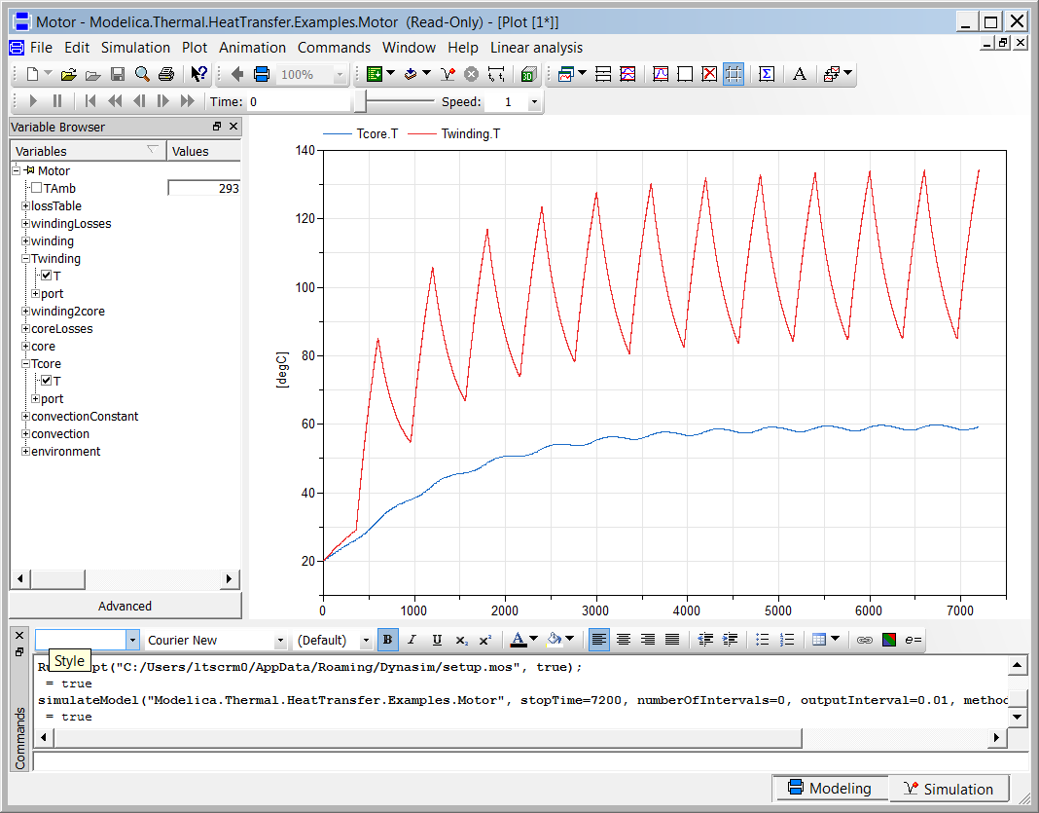
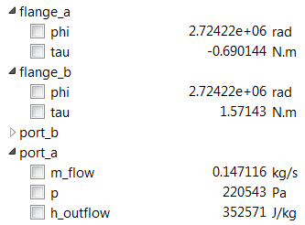
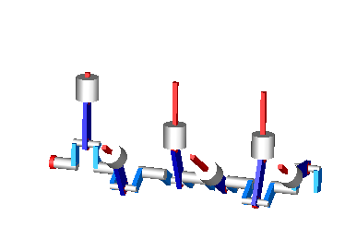
MODELICA & DYMOLA Overview
Dymola (Short) Overview
Dymola
Simulation Interface
Time evolution
2D Animation
Values
3D Animation
Launching Simulations
Parameters, Initial Values, Solvers,…
Results Post-processing
Curves, values, tables, 3D animations

Slide 27
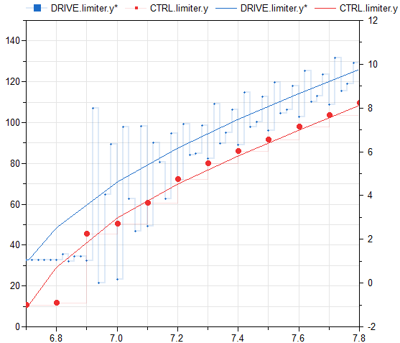
MODELICA & DYMOLA Overview
Dymola (Short) Overview
Dymola
period = 20 ms
Sub sampled signal
Sampled “Equipment” Control (20 ms)
Mechanical Pump
Sampled “System” Control (100 ms)
Electrical Motor
Based only on Modelica Standard Library components
Multi-physical example of a controlled motorized pump
Using Synchronous capabilities of MODELICA language

Slide 28
Dymola (Short) Training

Slide 29
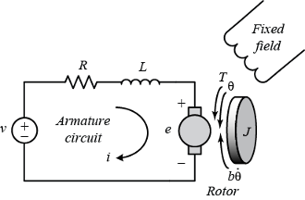
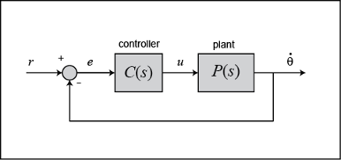
Use Case Overview
Dymola (Short) Training
*Source
“Control Tutorials for Matlab & Simulink”
Design PID Controller for a DC Motor*
Requirements
For 1rad/s step reference:
Setting Time < 2s
Overshoot < 5%
Steady-state error < 1%
Design
DC Motor Characteristics
J : moment of inertia of the rotor = 0.01 kg.m^2
b : motor viscous friction constant = 0.1 N.m.s
Ke : electromotive force constant = 0.01 V/rad/s
Kt : motor torque constant = 0.01 N.m/Amp
R : electric resistance = 1 Ohm
L : electric inductance = 0.5 H
Control Characteristics
To be determined !

Slide 30
Design PID Controller for a DC Motor
Dymola (Short) Training
Define Simulation Intent
Define Model Objective, Usage & Target
DC Motor Use Case
Define System Model Perimeter
Main Idea : “One Objective, One Model”
Objective : Define the engineering activities supposed to be supported by model & simulation
Pre-Design, Detailed Design, Test Bench Calibration, …
Performance, Root Cause, Behavioral analysis, …
Usage : Define how the model will be used by end-users
Simulation of single operating points, of an aircraft mission ?
Integration within other models ? Or Standalone usage ?
Acceptable Simulation Time, Robustness and Accuracy
Target : Define the computational hardware
Desktop Computer ? Real Time Simulator ? High Performance Computers
Objective
Design PID Controller for Performance Requirements
Build the Model
Simulate the Model
Usage
One single scenario, standalone, control design compatible
Exchange the Model
Target
Control Engineer Workstation

Slide 31
Design PID Controller for a DC Motor
Dymola (Short) Training
Define Simulation Intent
DC Motor Use Case
Simulation Mean Requirements
Simulation Mean Choices
Define System Model Perimeter
Objective
Design PID Controller for Performance Requirements
Modeling capability to represent multi-physical plant and control (discrete) modelling
Plant Model
Functional model based on main characteristics related to transient conditions
No need to take into account complex phenomena such starting phases (dry friction)
Control Model
- Continuous or sampled PID
Build the Model
Simulate the Model
Usage
One single scenario, standalone, control design compatible
Level of details focused on dynamic behavior
Quick calculation to support control design
Exchange the Model
Target
Control Engineer Workstation
No real time constraints

Slide 32
Design PID Controller for a DC Motor
Dymola (Short) Training
Define Simulation Intent
Define the Model Interfaces, Architecture & Functionalities
DC Motor Use Case
Define System Model Perimeter
Main Idea : “A model represents sub-parts of actual system definition”
Interfaces : Define the system external interfaces
Physical Interfaces, Signal Interfaces, …
Characteristics of interfaces linked with the simulation intent.
Architecture : Define the environment & internal system architecture
Architecture Breakdown (system, sub-system, assemblies, equipment),
Elements Connections,
Functionalities : Define implemented functionalities
Control laws, system protections,
Re-configuration
Interfaces
Plant : Electrical pins and speed sensor
Control : Speed Sensor, Command and control target
Build the Model
Simulate the Model
Architecture
Control + Plant architecture provided for the study
Exchange the Model
Functionalities
Normal operations only

Slide 33
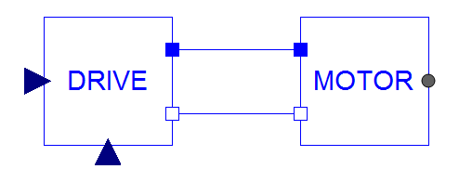
Design PID Controller for a DC Motor
Dymola (Short) Training
Define Simulation Intent
DC Motor Use Case
Electrical Pin (Positive)
Define System Model Perimeter
Reference Speed
Mechanical Flange
Interfaces
Plant : Electrical pins and mechanical flange
Control : Speed Sensor, Command and control target
Build the Model
Simulate the Model
Architecture
Control + Plant architecture provided for the study
Electrical Pin (Negative)
Actual Speed
Exchange the Model
Functionalities
Normal operations only

Slide 34


Design PID Controller for a DC Motor
Dymola (Short) Training
Define Simulation Intent
Build the Model using Adapted Modeling Environment
DC Motor Use Case
Define System Model Perimeter
Main Idea : “Use Adapted Modeling Tools and Languages”
Multi-physic : Use Multi-Physic modeling tool
Capability to easily combine several physical domains and level of details, …
Solvers adapted to solve stiff physical problems.
Sampled Calculation : Use modeling tool enabling the definition of different sampling time
Capability to model sampling effect on control properties (stability, robustness, performance…)
Elements Connections,
Standards : Use modeling tool based on industry standard (or ongoing ones)
MODELICA [DYMOLA], VHDL-AMS, Simulink (for control only) …
Multi-physic
Build the Model
Dymola
Sampled Calculation
Simulate the Model
Dymola
Simulink
Exchange the Model
Standards
Dymola
Simulink

Slide 35
Design PID Controller for a DC Motor
Dymola (Short) Training
Define Simulation Intent
Build the DC Motor Model
Dymola
Define System Model Perimeter
DCMotorSpeed/MotorDrive/Models
DC Motor Characteristics
J : moment of inertia of the rotor = 0.01 kg.m^2
b : motor viscous friction constant = 0.1 N.m.s
Ke : electromotive force constant = 0.01 V/rad/s
Kt : motor torque constant = 0.01 N.m/Amp
R : electric resistance = 1 Ohm
L : electric inductance = 0.5 H
Build the Model
Simulate the Model
Exchange the Model

Slide 36
Design PID Controller for a DC Motor
Dymola (Short) Training
Define Simulation Intent
Build the Motor Drive Model
Dymola
Define System Model Perimeter
DCMotorSpeed/MotorDrive/Models
Motor Drive Baseline Definition
Kp : 1 “Proportional Gain”
Ki : 1 “Integrator Gain”
Kd : 1 “Derivative Gain”
Nd : 100 “Numerical Derivative Approximation Parameter ”
Build the Model
Simulate the Model
Exchange the Model

Slide 37
Design PID Controller for a DC Motor
Dymola (Short) Training
Define Simulation Intent
Build the DC Motor Test Case
Dymola
Define System Model Perimeter
DCMotorSpeed/MotorDrive/exe
Build the Model
Requirements
For 1rad/s step reference:
Setting Time < 2s
Overshoot < 5%
Steady-state error < 1%
Simulate the Model
Exchange the Model

Slide 38
Design PID Controller for a DC Motor
Dymola (Short) Training
Define Simulation Intent
Test, Validate and Use the model
DC Motor Use Case
Define System Model Perimeter
Main Idea : “Simple to Complex”
Test : Perform tests using a bottom-up approach
Test & Validate equipment, then assemblies, then sub-systems models, …
Easy debugging of models.
Validate: Define reference scenarios to validate model behavior
Use several scenarios that activate all the available functionalities,
Assess robustness, computational time and accuracy,
Use: Publish the model
Document the model definition & limitations,
Tag the model in a configuration management system for traceability,
Enjoy your model !
Test
DC Motor Unit Test
Motor Drive Unit Test
DC Motor Design Case
Build the Model
Validate
Check unit test results
Simulate the Model
Exchange the Model
Use
Perform Control tuning
Determine DC Motor State Space Representation

Slide 39
Design PID Controller for a DC Motor
Dymola (Short) Training
Define Simulation Intent
DC Motor Unit Test
Dymola
Define System Model Perimeter
Build the Model
Simulate the Model
Exchange the Model

Slide 40
Design PID Controller for a DC Motor
Dymola (Short) Training
Define Simulation Intent
Motor Drive Unit Test
Dymola
Define System Model Perimeter
Build the Model
Simulate the Model
Exchange the Model

Slide 41
Design PID Controller for a DC Motor
Dymola (Short) Training
Define Simulation Intent
DC Motor Design Case
Dymola
Define System Model Perimeter
Build the Model
Simulate the Model
Requirements
For 1rad/s step reference:
Setting Time < 2s
Overshoot < 5%
Steady-state error < 1%
Motor Drive Baseline Definition
Kp : 1 “Proportional Gain”
Ki : 1 “Integrator Gain”
Kd : 1 “Derivative Gain”
Nd : 100 “Numerical Derivative Approximation Parameter ”
Exchange the Model

Slide 42
Design PID Controller for a DC Motor
Dymola (Short) Training
Define Simulation Intent
Perform Control Tuning
Dymola
Define System Model Perimeter
Build the Model
Simulate the Model
Requirements
For 1rad/s step reference:
Setting Time < 2s
Overshoot < 5%
Steady-state error < 1%
Motor Drive Tuned Definition
Kp : ?? “Proportional Gain”
Ki : ?? “Integrator Gain”
Kd : ?? “Derivative Gain”
Nd : 100 “Numerical Derivative Approximation Parameter ”
Exchange the Model

Slide 43
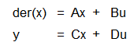





Design PID Controller for a DC Motor
Dymola (Short) Training
Define Simulation Intent
Determine DC Motor State Space Representation
Dymola
Define System Model Perimeter
Build the Model
Simulate the Model
Exchange the Model

Slide 44
Design PID Controller for a DC Motor
Dymola (Short) Training
Define Simulation Intent
Exchange & Integrate Models
DC Motor Use Case
Define System Model Perimeter
Main Idea : “Model your system and integrate others models”
Exchange: Share model with your internal or external customers
Capitalize the modeling effort, Enables Collaborative Design,
Requirement for most system developments (Deliverables)
Integrate: Request for models outside the system perimeter
Minimize modeling effort,
Reduce modeling error (elements modeled by the owner of the perimeter),
Standards: Use standard exchange format
Simulink : S-Function (but only supported by Simulink)
Functional Mock-Up Interface (supported by more than 30 tools)
Scrambled Source Code (C code for instance)
Exchange & Integrate Models
Export DC Motor Model to FMU
Import FMU in Simulink
Compare FMU vs Simulink results on DC Motor
Validate control design
Build the Model
Simulate the Model
Exchange the Model

Slide 45


Design PID Controller for a DC Motor
Dymola (Short) Training
Define Simulation Intent
Exchange & Integrate Models
Simulink
Dymola
Define System Model Perimeter
Dymola
Build the Model
Simulate the Model
Simulink
Exchange the Model

Slide 46
System Simulation at Liebherr

Slide 47

LTS System Simulation Platform
System Simulation at Liebherr
LTSAircraftLib
CAT Simulation
LTSValveLib
System Simulation Platform
Based on standards (Modelica, Simulink,…)
Enabling interoperability between tools (FMI, C-code,…)
Addressing the whole development cycle
Multi-domain Strategy
Enabling models interoperability (control, electrical, thermal, thermodynamic performance,…)
Transverse Capabilities
LTSInterfaceLib
Fault / Degradation
Analysis
Hardware In
The Loop Verification
LTSPerformancesLib
LTSThermalLib
Valves
Design
Thermal
Analysis
Simulink
LTSRequirementsLib
Control Design
Simulation
Platform
Requirements
Checking
Power
Electronics
Analysis
Thermodynamic
Analysis
LTSElectricalLib
Mechatronics
Analysis
LTSPreDesignLib
Transverse
System
Architecture
Pre-Design
LTSMecatronicLib
Equipment

Slide 48
Use Cases
System Simulation at Liebherr
Architecture Definition
Define Cooling/Heating Requirements (Flow Schedule)
Define Physical Architecture & Allocate Performances
Performance Assessment
Define the performance compliance of system design over the Aircraft flight envelope
Control Design
Define Control Laws to fulfill transient performances
Computer Verification
Verify the compliance of software implementation versus its specification
A/C Integration
Verify system integration into the aircraft

Slide 49

Use Cases
System Simulation at Liebherr
Architecture Definition
Define Cooling/Heating Requirements (Flow Schedule)
Performance Assessment
Main Inputs : Customer & Regulation Requirements
Control Design
Computer Verification
A/C Integration
Heat Loads
Flow Schedule

Slide 50




Use Cases
System Simulation at Liebherr
Architecture Definition
Heat Loads
Water Cont.
Dymola
Cooling
Heating
Performance Assessment
Control Design
Mass Flow Rates
Computer Verification
Recirculation
Multi Zones
A/C Integration
Moist Air
Non-Linear Solver
Sim. Time : <5s

Slide 51


Use Cases
System Simulation at Liebherr
Architecture Definition
Define Physical Architecture & Allocate Performances requirement on design cases
Performance Assessment
Main Inputs : Flow Schedule, Architecture Baseline
System Performance
Equipment Performance
Control Design
Computer Verification
Mass Flow Rate
Water Content
A/C Integration
Temperature
Pressure

Slide 52


Use Cases
Simulation at LTS
Architecture Definition
Fixed Mass Flow, Pressure & Temperature
ACM Performance
Diameters
Rotating Speed
Pressure Ratio
Efficiency
Performance Assessment
Control Design
Fixed Mass Flow, Pressure & Temperature
Fixed Pressure & Temperature
Water Extractor Performance
Efficiency
Pressure Losses
Computer Verification
Fixed Pressure
A/C Integration
Non-Linear Solver
Sim. Time : <1s
HX Performance
Wet Efficiency
Pressure Losses
Inverse Computation
Modular Model

Slide 53


Use Cases
Simulation at LTS
Architecture Definition
Define the performance compliance of system design over the Aircraft flight envelope
Performance Assessment
Main Inputs : Frozen Architecture, Equipment Performances Maps
BAS 1
BAS 2
Detailed System Performance
Control Design
Corner Cases
Computer Verification
PACK 1
PACK 2
Performance Report
Control logics validation
A/C Integration
Specification Compliance for Thermodynamic Performance
Distribution

Slide 54




Use Cases
Simulation at LTS
Architecture Definition
Performance Margin
Computer
Preliminary Control Strategy Validation
Performance Assessment
Performance Report
Control Design
Computer Verification
Operating Points for Main components
A/C Integration
IAMS – Cyber Physical Model

Slide 55

Use Cases
Simulation at LTS

Slide 56
Use Cases
Simulation at LTS
Architecture Definition
Define Control Laws to fulfill transient performances
Performance Assessment
Main Inputs : Equipment Identification or Model, Control Strategy
Computer
Control Design
Specification of Control Algorithm
Commands
Sensors
Computer Verification
Configuration
Specification Compliance for Dynamic Performance
A/C Integration
Physical Hardware

Slide 57




Use Cases
Simulation at LTS
Architecture Definition
Define Control Laws to fulfill transient performances
Performance Assessment
Main Inputs : Equipment Identification or Model, Control Strategy
Computer
Control Design
Control Model
Specification of Control Algorithm
Commands
Sensors
Computer Verification
Configuration
Specification Compliance for Dynamic Performance
Dymola
Physical Model
A/C Integration
Physical Hardware

Slide 58







Use Cases
Simulation at LTS
Architecture Definition
Control Robustness
Control Stability
Performance Assessment
Control Design
Control Model
Computer Verification
Computer
A/C Integration
Limited Over/Undershoots
Control Specification

Slide 59
Use Cases
Simulation at LTS
Architecture Definition
Validation of Control Architecture on Real Physical Hardware
Performance Assessment
Main Inputs : Control Model, Physical Hardware
RCP Computer
Rapid Control Prototyping (RCP)
Control Design
C code
Control Model
Specification of Control Algorithm
Commands
Sensors
Computer Verification
Configuration
Specification Compliance for Dynamic Performance
A/C Integration
Physical Hardware

Slide 60


Use Cases
Simulation at LTS
Architecture Definition
Verify the Compliance of Software Design versus its Specification
Performance Assessment
Main Inputs : Control Law Specification, Software Specification
Computer
Early verification of software Design (Scade Virtual System)
Control Design
Computer Model
Commands
Sensors
Verify Compliance of Software Design
Computer Verification
Configuration
A/C Integration
Physical Model
Real actuators (Hardware)

Slide 61

Use Cases
Simulation at LTS
Architecture Definition
Verify the Compliance of Software Implementation versus its Specification
Performance Assessment
Main Inputs : Control Law Specification, Software Specification, Electronic Cards
Implementation :
Control laws,
Monitoring,
Logics
Low level Drivers
Control Design
Computer Verification
Certified C Code Generator
Computer
Verify Compliance of Software Implementation
A/C Integration

Slide 62




Use Cases
Simulation at LTS
Architecture Definition
Physical Model
Hardware Controller
Real Time Simulator
Performance Assessment
Control Design
Computer Verification
Hardware In the Loop Simulation (HiL)
A/C Integration
Synoptic
Hardware Actuators
Mature Software Implementation Ready for system test benches

Slide 63


Use Cases
Simulation at LTS
Architecture Definition
Verify system integration into the aircraft
Performance Assessment
System Integration Test Benches
Validation of System integration within the A/C environment (Customer Tests Benches : iron bird, Cabin 0,…)
Control Design
System
Models
Computer Verification
A/C Integration
Aircraft Network Simulation

Slide 64
Future of System Simulation

Slide 65










Toward a Model Based World !
Future of System Simulation
MB Engineering
Consider the whole enterprise inlcuding Design, Manufacturing, Factory Design and Services
System Definition
Specification, Architecture,
Functions, Interfaces (Models)
Analysis
Stress, CFD, Performances,…
Manufacturing
Product Manufacturing
Information, …
Dymola
MBSE
General trend for Aeronautic and other Industries
Design Definition
Geometry, Material, Data,
Life Cycle
MBA
MBM
MBD

Slide 66






Understanding MBSE
Future of System Simulation
Before defining MBSE, lets have a look on the product design definition story !
Product Design Definition – Before
Document Based Approach (“D”)
Products defined by several drawings,
Need to synchronize all drawings together in case of change,
Difficulties to have a global product view,
Difficulties to exchange with customer (check product physical integration),
Requires to rebuild information to preform analysis (CFD, FEM,…),
MBA
Analysis – Model Based Analysis
Analysis – Stress Calculation
Design Definition
Drawings (Documents)
REBUILD Geometry
REBUILD Geometry
D
Analysis - Fluid Dynamics

Slide 67

Understanding MBSE
Future of System Simulation
Introduction of modeling for drawings using CATIA
Product Design Definition - Currently
Model Based Approach (“MBD”)
Products defined uniquely and centralized,
Generation of drawings enforcing their mutual coherence,
Enable to have a global product view,
Support Virtual Integration of the product within the Customer environment,
Enable to consume design definition for analysis,
MBA
Analysis – Model Based Analysis
Analysis – Stress Calculation
Design Definition
DMU (Model)
USE Geometry
USE Geometry
MBD
Analysis - Fluid Dynamics

Slide 68





Understanding MBSE
Future of System Simulation
MBA
System definition similar of having several drawings to define the information
System Design Definition – Currently
Textual Based Approach (“SE”)
System definition based on document / textual form (specifications,…),
Need to synchronize several specifications (software, requirements, interfaces, …) in case of change,
Difficulties to have a global system view due to increasing complexity, to assess impact analysis, system compliance.
Difficulties to exchange in an unambiguous way with customers,
Requires to rebuild system definition for analysis
Analysis – System Performances
Dymola
System Definition
Specification, Architecture,
Functions, Interfaces (Textual)
REBUILD Architecture
Analysis – System Regulation
REBUILD Architecture
REBUILD Architecture
SE
Analysis – Computer Validation

Slide 69

Understanding MBSE
Future of System Simulation
MBA
MBSE approach similar to the introduction of CATIA for product definition
System Design Definition – Future
Model Based Approach (“MBSE”)
System defined uniquely and centralized,
Generation of documents enforcing their mutual coherence,
Enable to have a global product view,
Support integration of the product within the customer environment,
Enable to consume design definition for analysis,
Analysis – System Performances
System Definition – Model Based System Engineering
Dymola
System Definition
Specification, Architecture,
Functions, Interfaces (Models)
USE Architecture
Analysis – System Regulation
USE Architecture
USE Architecture
MBSE
Analysis – Computer Validation

Slide 70







MBSE Vision
Future of System Simulation
Design Justification
System Definition
Specification, Architecture,
Functions, Interfaces (Models)
Design Definition
Geometry, Material, Data,
Life Cycle
System Design Justification
MBSE
MBD
Analysis
Stress, CFD, Performances,…
Dymola
Architecture,
Functions,
Interfaces,
Scenarios
Geometry,
Material, Performance Data,..
MBA
Dymola
SCADE
Simulink

Slide 71
Fluid Modelling & Humidity Effect

Slide 72




Conservation Equations
Fluid Modelling & Humidity Effect
Dry Air – Perfect Gas
State Equation $\frac{P}{ρ}=RT$
Specific Heat $C_{p}=\frac{γR}{γ−1},$ $γ=\frac{C_{p}}{C_{v}}$
Enthalpy $h=C_{p}T$
Conservation Equations
Mass Conservation
$0=\sum{{\dot{m}}_{i}}$
Energy Conservation
$$0=\sum{{\dot{m}}_{i}×h_{i}}+\dot{Q}+\dot{W}$$
Fluid Component : 1 Input / 1 Output Case
Mass Conservation
$${\dot{m}}_{A}+{\dot{m}}_{B}=0$$
Energy Conservation
$${\dot{m}}_{A}h_{A}+{\dot{m}}_{B}h_{B}+\dot{Q}+\dot{W}=0$$
$${\dot{m}}_{A}C_{p}\left(T_{B}−T_{A}\right)=\dot{Q}+\dot{W}$$
$$T_{B}=T_{A}+\frac{\dot{Q}+\dot{W}}{{\dot{m}}_{A}C_{p}}$$
A
B

Slide 73








Conservation Equations
Fluid Modelling & Humidity Effect
Q1 - Calculate required “Q_flow” to ensure 10°C temperature variation on the ducts
Practice – Dry Heat Exchange
Build the following model (Dry_HeatExchange)
$$L=1m$$
$$D=10 cm$$
$$\dot{m}=30kg.min^{−1}$$
$$T=15°C$$
$$X=\{0,1\}$$
$$P=1.01325 bar$$
$$water fraction$$
$$dry air fraction$$
$$\dot{m}=30kg.min^{−1}$$
$$T=15°C$$
$$X=\{0,1\}$$
$$P=1.01325 bar$$

Slide 74



Conservation Equations
Fluid Modelling & Humidity Effect
Fluid Component : 2 Inputs / 2 Outputs Case
Mass Conservation
$${\dot{m}}_{A}+{\dot{m}}_{B}+{\dot{m}}_{C}+{\dot{m}}_{D}=0$$
Energy Conservation
$${\dot{m}}_{A}C_{p}\left(T_{A}−T_{M}\right)+{\dot{m}}_{B}C_{p}\left(T_{B}−T_{M}\right)=0$$
$$T_{M}=\frac{{{\dot{m}}_{A}T_{A}+\dot{m}}_{B}T_{B}}{{{\dot{m}}_{A}+\dot{m}}_{B}}$$
$$h_{M}=C_{p}T_{M}$$
Practice – Mixing
A
C
B
D
Q1 - Explain observed temperature variations
Q2 - What is the fundamental relation between temperature and fluid flow ?

Slide 75



Moist Air Modelling
Fluid Modelling & Humidity Effect
Moist Air
Moist Air State Variable
Mass Fractions w.r.t Moist Air Mass
$$m=m_{air}+m_{water}→1=X_{air}+X_{water},$$
$$\left[X_{i}\right]≡\frac{kg}{kg}of moist air$$
Mass Fractions w.r.t. Dry Air Mass
$$m=m_{air}+m_{water}→\frac{m}{m_{air}}=1+x_{water},$$
$$\left[x_{i}\right]≡\frac{kg}{kg}of dry air$$
Mass Conservation Equation $0=\sum{{\dot{m}}_{i}X_{i}}$
Vapor Water Content
$$X_{v}=f\left(P,T,X_{water}\right)$$
if not saturated : $X_{v}=X_{water}$
if saturated : $X_{v}<X_{water}$
and $X_{water}=X_{v}+X_{l}$ if $T>0°C$ (liquid)
or $X_{water}=X_{v}+X_{i}$ if $T≤0°C (ice)$
Wet Enthalpy (simplified model)
$$h\left(P,T,x_{water}\right)≈C_{p}T+x_{v}L_{v}+x_{i}L_{l}$$
Where $C_{p}≈1005$ J/kg/K, $L_{v}≈2503.7 10^{3}$ J/kg and $L_{l}=335 10^{3}$ J/kg
$$P$$ | $$T$$ | $$X$$
Mixture Pressure | Mixture Temperature | Mass Fractions
Pa | K | kg/kg of moist air

Slide 76


Moist Air Impact
Fluid Modelling & Humidity Effect
Q1 – Explain observed differences w.r.t. dry air case
Practice – Wet Heat Exchange
Build the following model (Wet_HeatExchange)
$$L=1m$$
$$D=10 cm$$
$$\dot{m}=30kg.min^{−1}$$
$$T=15°C$$
$$X=\{0.00,1.000\}$$
$$P=1.01325 bar$$
$$\dot{m}=30kg.min^{−1}$$
$$T=15°C$$
$$X=\{0.015,0.985\}$$
$$P=1.01325 bar$$

Slide 77








Cold Power
Fluid Modelling & Humidity Effect
Cabin Dry Cold Power
Equations
$${\dot{m}}_{MIX}h_{MIX}+{\dot{m}}_{OUT}h_{OUT}+{\dot{Q}}_{loads}=0$$
$${\dot{m}}_{MIX}{(h}_{MIX}−h_{CAB})+{\dot{Q}}_{loads}=0$$
$$−{\dot{Q}}_{fluid}+{\dot{Q}}_{loads}=0$$
$${\dot{Q}}_{fluid}={\dot{m}}_{MIX}{(h}_{CAB}−h_{MIX})$$
Practice – Dry Cold Power
$${\dot{Q}}_{loads}$$
$${\dot{Q}}_{fluid}$$
$$T_{CAB}$$
$$\dot{m}=0.5 kg/s$$
Q1 – Calculate T_F value to obtain T_Cabin=24°C.
Q2 – Validate your calculation by using the model

Slide 78



Cold Power
Fluid Modelling & Humidity Effect
Cabin Wet Cold Power
Equations
$${\dot{m}}_{MIX}h_{MIX}+{\dot{m}}_{OUT}h_{OUT}+{\dot{Q}}_{loads}=0$$
$${\dot{m}}_{MIX}{(h}_{MIX}−h_{CAB})+{\dot{Q}}_{loads}=0$$
$$−{\dot{Q}}_{fluid}+{\dot{Q}}_{loads}=0$$
$${\dot{Q}}_{fluid}={\dot{m}}_{MIX}{(h}_{CAB}−h_{MIX})$$
Practice – Wet Cold Power
$${\dot{Q}}_{loads}$$
$${\dot{Q}}_{fluid}$$
$$T_{CAB}$$
Q1 – Explain observed evolutions

Slide 79

Cold Power
Fluid Modelling & Humidity Effect
Cabin Wet Cold Power
Equations
$${\dot{m}}_{MIX}h_{MIX}+{\dot{m}}_{OUT}h_{OUT}+{\dot{Q}}_{loads}=0$$
$${\dot{m}}_{MIX}{(h}_{MIX}−h_{CAB})+{\dot{Q}}_{loads}=0$$
$$−{\dot{Q}}_{fluid}+{\dot{Q}}_{loads}=0$$
$${\dot{Q}}_{fluid}={\dot{m}}_{MIX}{(h}_{CAB}−h_{MIX})$$
Exercice – Dry Air Rated Temperature
Q1 – Apply conservation equations and derive the following relation:
$$W_{th}={\dot{m}}_{F}\left[C_{p}\left(T_{CAB}−T_{F}\right)+X_{l}^{F}L_{v}\right]$$
Q2 – From the previous relation, determine the $T_{dar}$ definition using the following equation:
$$W_{th}={\dot{m}}_{F}\left[C_{p}\left(T_{CAB}−T_{DAR}\right)\right]$$
$${\dot{Q}}_{loads}$$
$${\dot{Q}}_{fluid}$$
$$T_{CAB}$$

Slide 80
Flow Schedule Use Case

Slide 81

Heat Loads Assessment
Flow Schedule Use Case
Heat Loads Budget in different Aircraft zones
Metabolic Loads
Occupants Number (crew member + passengers)
1 PAX ≈ 70W + 1g/min of water produced at 24°C
1 Working crew member ≈ 140W + 2.5g/min of water produced at 24°C
Taking into account produced water as a load only in case of recirculation
Electrical Heat Loads
Lights
Services Areas
Avionic bays
In Flight Entertainment (videos,…)
For quick pre-design, consider : Pelec = 800 W + 60W / pax
Solar Loads
Efficient Windows Area = 0.5 x Total Windows Area (sun light only on one side of the aircraft !)
Windows Transmissivity : ~0.7
Solar Heat Flux :1135 W/m2 on ground for clear weather

Slide 82


Heat Loads Assessment
Type | U [W/m2/K]
Helicopter / Military Aircraft | 5
General Aviation | 2.4
Business Jet | 1.5
Regional Jet | 1
Single Aisle & Long Range | 0.7
Flow Schedule Use Case
External Loads : Conduction and Convection
Heat Exchange coefficient between Aircraft skin and Cabin Air (internal convection + conduction)
Total area estimated based on the fuselage diameter (D) and Pressurized Area Lenght (L)
Skin temperature
Ground Hot Day Tp (°C) = 1.2368 x OAT (°C)
Ground Cold Day Tp = OAT
Flight Tp(K) = OAT (K) x (1+0.18M²)
UA = global Aircraft conductivity (W/K)
L
D

Slide 83






Cabin Zone Model
Flow Schedule Use Case
Heat Loads included
Electrical Power
IFE Power
Solar Heat Flux
Metabolic Power
External Convective Power
Heat Loads Model
Metabolic Power
$$\dot{Q}=\left(N_{pax}+2×N_{crew}\right)×\left(188−4.7×\left(T_{CAB}−273.15\right)\right)$$
External Convective Power
$$\dot{Q}=UA_{ext}\left(T_{skin}−T_{CAB}\right)$$
Skin Temperature
$$T_{skin}=\left\{\begin{matrix}OAT×1.2368 & si M<1e^{−3} et OAT>0 \\ OAT & si M<1e^{−3} et OAT≤0 \\ OAT×\left(1+0.18×M^{2}\right) & sinon\end{matrix}\right.$$

Slide 84


Cabin Zone Model
Flow Schedule Use Case
Open « CabinMission_PID » Model
Launch simulation

Slide 85
Cabin Zone Model
Flow Schedule Use Case
Practice – Cabin Zone Model
Plot heat loads evolution (total and particular)
Q1 – In which configuration you observe maximum heat loads ? Explain why.
Q2 – Which conditions enables ECS design for cooling case ? Express these conditions in terme of Aircraft configuration and mission.
Q3 – Which conditions enables ECS design for heating case ? Express these conditions in terme of Aircraft configuration and mission.

Slide 86

Cabin Zone Model
Flow Schedule Use Case

Slide 87
Flow Schedule Assessment
Flow Schedule Use Case
3 Cabin Zones
Recirculation

Slide 88



Flow Schedule Assessment
Flow Schedule Use Case
$$P_{CAB}=f(Alt)$$
Thermal Comfort Mass Rate
Blown temperature limits into cabin
Without passengers : ~3°C minimum, ~70°C maximum,
With passengers : between ~8°C and ~50°C.
Blown liquid water limit into cabin
≈1 to 2 g/kg of liquid water maximum.
Pressurization Mass Flow Rate
Pressurization mass flow rate estimated based on an equivalent aircraft leak area :
End of life Aircraft leak area generally provided by the aircraft manufacturer,
Outflow Valve minimum area (minimum regulation position). For pre-design, a rought estimation would consider half of the end-of-life aircraft leak,
Off-takes coming from power electronics cooling valves.
Fresh Air (O2)
Fresh flow determined by the number of occupants
Passengers
Crew (including pilots)
Normal Mode | Failure Mode
0.55 lb/min/pax | 0.40 lb/min/pax
$$∀ Modes$$
10 cfm/min

Slide 89


Flow Schedule Assessment
Flow Schedule Use Case
Support for High Level Architecture Decisions
Air System Bleeding on Engine for :
Fresh flow, Heating, Cooling, Pressurization
Low recirculation
Air System Bleeding on Engine for :
Fresh flow, Heating, Pressurization
Refrigerant Cycle
Cooling

Slide 90
Flow Schedule Practice !

Slide 91

Flow Schedule Model
Flow Schedule Practice !

Slide 92

Aircraft Data
Flow Schedule Practice !
Customer Requirements
Aircraft Characteristics
Passengers Number
Mission
Regulation
Choose your Aircraft
Collect A/C Characteristics,
Estimate passengers & configurations
Enter your values for each zone

Slide 93


Parameters Calibration
Flow Schedule Practice !
Flow Split setting between zones
Starting with no recirculation (RECIRC = 0)
Change flow split to reach 24°C in all zones on ground only
Recirculation setting
Technology limitation : Maximum Blown TDAR = -20°C

Slide 94




Results Visualization
Flow Schedule Practice !
Using provided script to ease results post-treatment

Slide 95

Design Proposal
Flow Schedule Practice !
Flow Schedule Proposal
Affine function w.r.t the altitude
Require margin of 10% (i.e. the gap between the maximum heat load at each altitude shall be majored by 10%)
Provide function equation !
Flow Schedule Proposal

Slide 96

Thank you for your attention !

